Slide 1


SMART INDIA HACKATHON 2026
Problem Statement ID – 26102
Problem Statement Title- AI-Powered MPLADS Monitoring & Fraud Detection System
Theme- Smart Automation
PS Category- Software
Team ID- 262
Team Name - Cyber LEEK

Slide 2
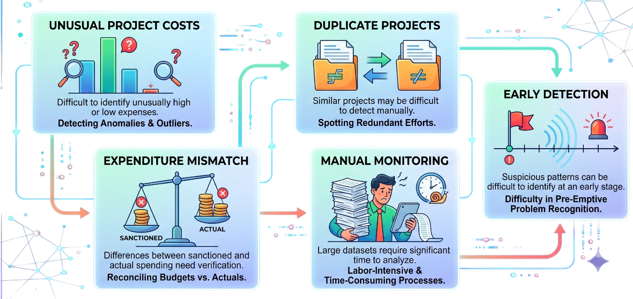
AI-Powered MPLADS Monitoring & Fraud Detection System
Cyber LEEK
A centralized AI-powered platform that continuously analyzes MPLADS project, financial, payment and progress data to identify unusual patterns and prioritize high-risk cases.
Key Challenges
Unusual Project Costs: Difficult to identify unusually high or low expenses in large Dataset manually.
Duplicate Projects: Similar projects may be difficult to detect manually.
Expenditure Mismatch: Differences between sanctioned and actual spending need verification.
Manual Monitoring: Large datasets require significant time to analyze.
Early Detection: Suspicious patterns can be difficult to identify at an early stage.

Slide 3
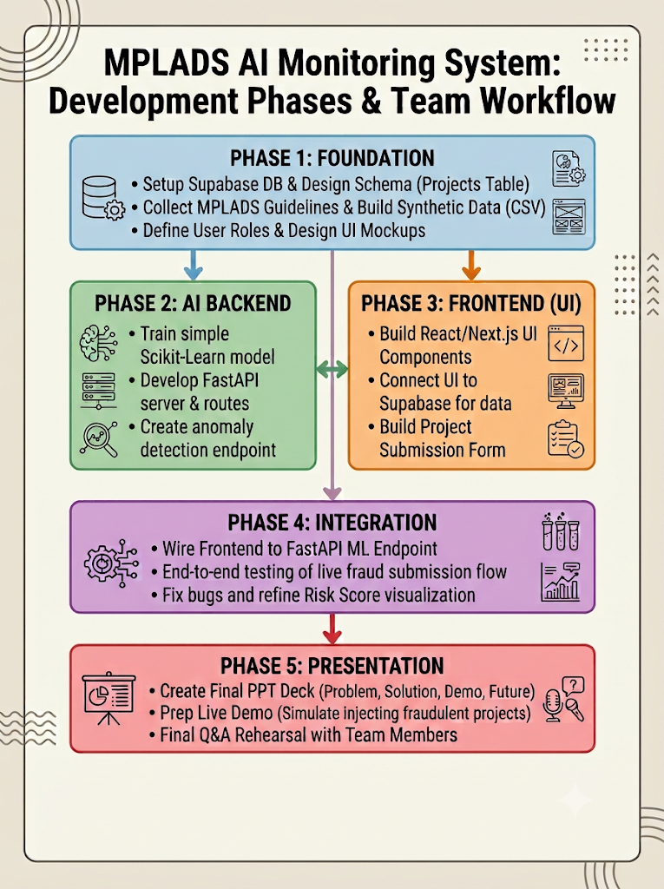
TECHNICAL APPROACH
Cyber LEEK
Tech Stack
Frontend UI: React / Next.js + Tailwind CSS (Deployed on Vercel)
Backend API: Python (FastAPI) (API layer connecting UI and ML)
Database: Supabase (PostgreSQL) (Cloud database for seed and live data)
AI / ML Model: Scikit-Learn (IsolationForest) (Anomaly detection & risk scoring)

Slide 4
FEASIBILITY AND VIABILITY
Cyber LEEK
Feasibility:
Accessible Tech Stack: FastAPI provides a fast, seamless bridge between the ML layer and the frontend, while Next.js and Tailwind CSS enable rapid, modular UI development.
Rapid Prototyping & Infrastructure: Vercel offers instant frontend hosting, and Supabase provides a ready-to-use managed PostgreSQL backend, eliminating complex database setup.
Efficient ML Implementation: Using Scikit-Learn's IsolationForest instantly isolates statistical outliers and assigns risk scores without the immense computing power needed for deep learning.
Viability:
Enterprise-Grade Foundation: Supabase is built on PostgreSQL, a proven open-source standard widely trusted for secure and structured government data management.
Low Cost & High Scalability: Relying on open-source frameworks and serverless databases avoids expensive enterprise licenses while easily scaling to handle high transaction volumes.
Maintainable Architecture: The strict separation of concerns (Next.js for UI, FastAPI for logic/ML, Supabase for data) makes the system highly organized and easy for government IT teams to inherit and maintain.

Slide 5
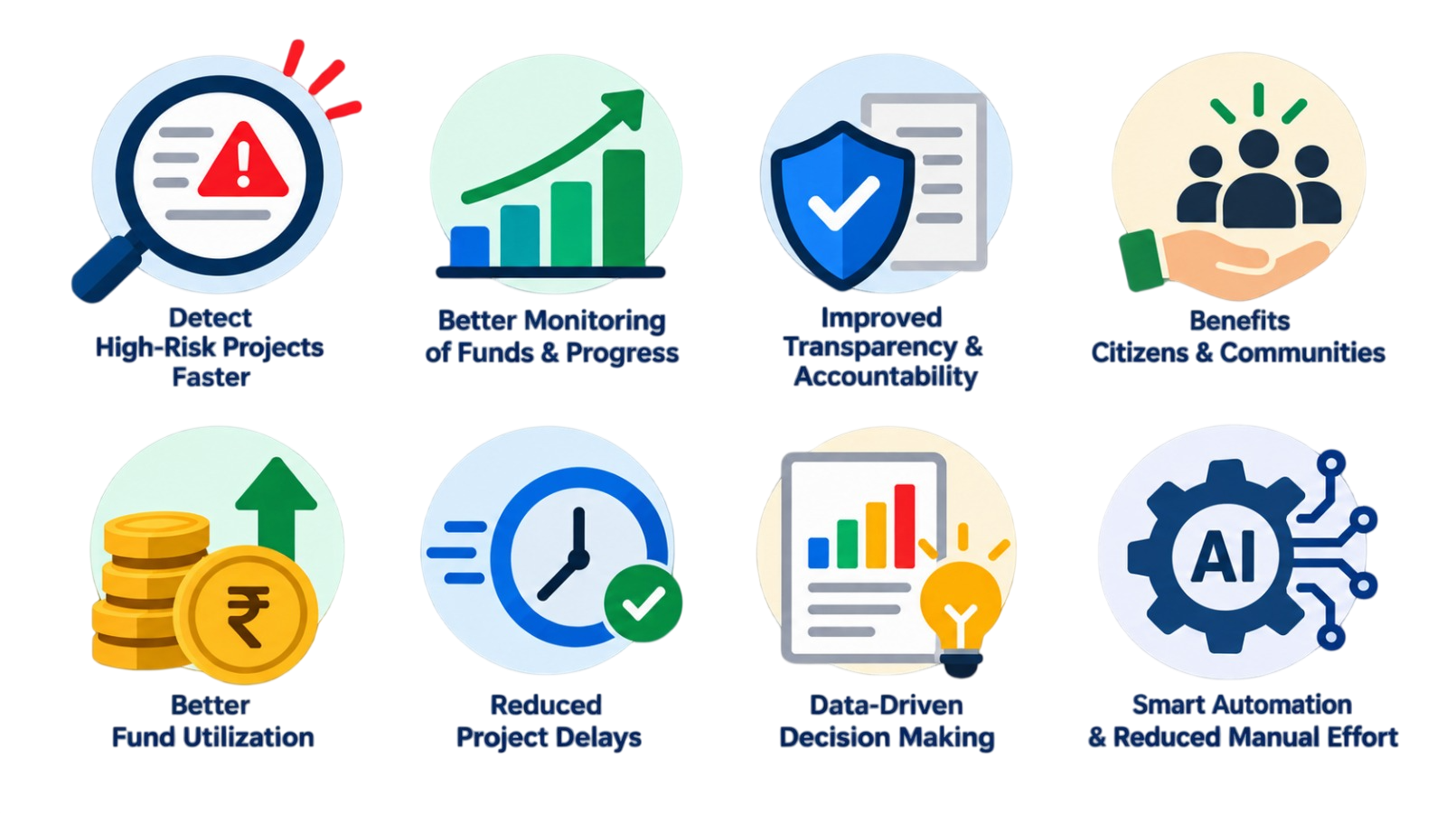
IMPACT AND BENEFITS
Cyber LEEK
Potential Impact on Target Audience:
Faster identification of suspicious and delayed projects
Better monitoring of MPLADS funds and project progress
Improved transparency and accountability
Benefits of the Solution:
Early anomaly and risk detection
Reduced manual monitoring effort
Better fund utilization and decision-making
Timely intervention in high-risk projects

Slide 6
RESEARCH AND REFERENCES
Cyber LEEK
References:
Official MPLADS Portal: https://mplads.gov.in/
MPLADS eSAKSHI / Dashboard: https://mplads.gov.in/
MPLADS Scheme Guidelines and Reports: https://mplads.gov.in/
MPLADS Dashboard: https://mplads.mospi.gov.in/digigov/dashboard.html
Our Research Approach:
MPLADS Data & Reports → Data Analysis → AI-Based Anomaly Detection → Risk Scoring → Smart Alerts

